Slide 1
Project ELIZA LR1307
Mustweek presentation
August 2016

Slide 2
Who am i?
Mgr. Marie Zagorova
Studied Information science and Librarianship at Faculty of Arts, Masaryk University.
Worked in Central Library of Faculty of Arts for 4 years.
Started working on ELIZA Project in 2013.
Interested in digital libraries and electronic resources.

Slide 3
What is ELIZA?
ELIZA is one of 9 projects of Czech Ministry of Education programme LR that provides electronic resources to research institutions.
…is coordinated by Faculty of Arts, MU.
…has project team of 4 members.
…provides access to 19 e-resources.
…covers with access 17 institutions in the whole Czechia.
…lasts from 2013 to 2017, with access to e-resources till 2018.

Slide 4
How does it work?
…The Ministry of Education redistributes funds from European Union.
…projects are usually for 2 and more years.
…Masaryk University was a leader in 3 previous programmes.
…the proposal was submitted in January 2013, the project was approved in May 2013 and officially started in August 2013.
…the subsidy from the Ministry covers 75% of total costs.

Slide 5
participating universities

Slide 6
Participating institutions

Slide 7
Fields covered
ENGLISH AND AMERICAN STUDIES
(Literature Online, Literature Resource Centre)
FILM STUDIES AND AUDIOVISUAL CULTURE
(Film&Television Literature Index, Film Indexes Online+FIAF)
HISTORY OF ART
(Art Index Retrospective, Art Source, Oxford Art Online, Art and Design Coll.)
CLASSICAL AND RELIGIOUS STUDIES
(Brepolis, ATLA, TLG, L‘Année Philologique, HNC)
LAW STUDIES
(Hein, Oxford and Kluwer Law Journals, Beck, Westlaw, IEL)

Slide 8
ENGLISH AND AMERICAN STUDIES
Literature Online: digital library with more than 300,000 full-text searchable works of English and American poetry, drama and prose.
Literature Resource Center: biographic, bibliographic and contextual information about more than 145,000 authors.

Slide 9
FILM STUDIES AND AUDIOVISUAL CULTURE
Film&Television Literature Index: full-text and bibliographic database, which includes full texts for more than 100 journals and 100 books.
Film Indexes Online+FIAF: A set of three major databases in the area of film (American Film Institute Catalog – film records from 1893 to 1972; The FIAF International Film Archive Database – bibliographic and factual database of 127 film archives from more than 65 countries; Film Index International - detailed records on films from 170 countries from the first silent films to present)

Slide 10
HISTORY OF ART
Art Index Retrospective: bibliographic database containing bibliographic data from more than 390 art periodicals between 1929 and 1984
Art Source: full-text source for the area of art and architecture
Oxford Art Online: collection of encyclopaedias and online resources in the area of art
Art and Design Coll.: abstracts and bibliographic databases for the area of art and architecture

Slide 11
CLASSICAL AND RELIGIOUS STUDIES
Brepolis Latin Complete, ATLA with ATLA Serials, Thesaurus Linguae Graecae, L‘Année Philologique, Hellenic National Corpus
Unique resource of Latin texts, Teological and Religious full-texts, Ancient and Byzantine literary works and language corpus of modern Greek language.
They are available via special site maintained by Department of Classical Studies at Faculty of Arts and Institute of Computer Science.

Slide 12
Access to e-resources
Dostupnost zdrojů na zúčast­něných institucích | Literature Online | Literature Recource Center | Brepolis | ALTA + ATLAS | Thesaurus Linguae Graecae | L´Année Philologique | National Hellenic Corpus | Art Index Retrospective | Art Source | Oxford Art Online | Art and Design Collection | Film and Television Literature Index With Full Text | Film Indexes Online + FIAF | Hein OnLine | Oxford Journal Law/Archive | Westlaw | Beck OnLine | International Encyclopedia of Law | Kluwer Law Journals
MU | ● | ● | ● | ● | ● | ● | ● | ● | ● | ● | ● | ● | ● | ● | ● | ● | ● | ● | ●
NFA |  |  |  |  |  |  |  |  |  |  |  | ● | ●
AMU |  |  |  |  |  |  |  |  |  |  |  | ● | ●
UK-FF | ● | ● | ● | ● | ● | ● |  |  |  |  |  | ● | ●
UK-PDF | ●
UK-HTF |  |  |  | ● |  | ●
UK-KTF |  |  |  | ●
UK-ETF |  |  |  | ●
UK-PRF |  |  |  |  |  |  |  |  |  |  |  |  |  |  |  |  | ● |  | ●
UPOL | ● | ● | ● | ● |  |  |  |  | ● | ● |  | ● | ●
UTB | ● |  |  |  |  |  |  |  | ● | ● | ●
MKP |  |  |  |  |  |  |  |  |  | ● |  |  | ●
JČU | ● |  |  | ●
NKP | ● | ●
SLU | ● | ●
UJEP | ● | ● |  |  |  |  |  |  | ●
UPCE | ● | ●
UHK | ● | ●
FÚ AV ČR |  |  | ● |  | ● | ●
ÚDU AV ČR |  |  |  |  |  |  |  |  | ●
NGP |  |  |  |  |  |  |  |  | ●
…depends on institution

Slide 13
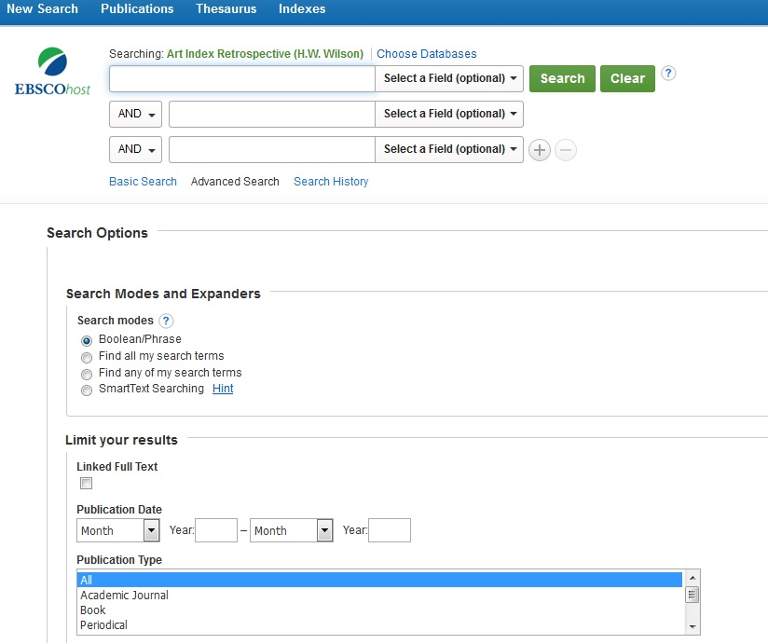
Access to e-resources
…well known platform vs. unknown interface

Slide 14
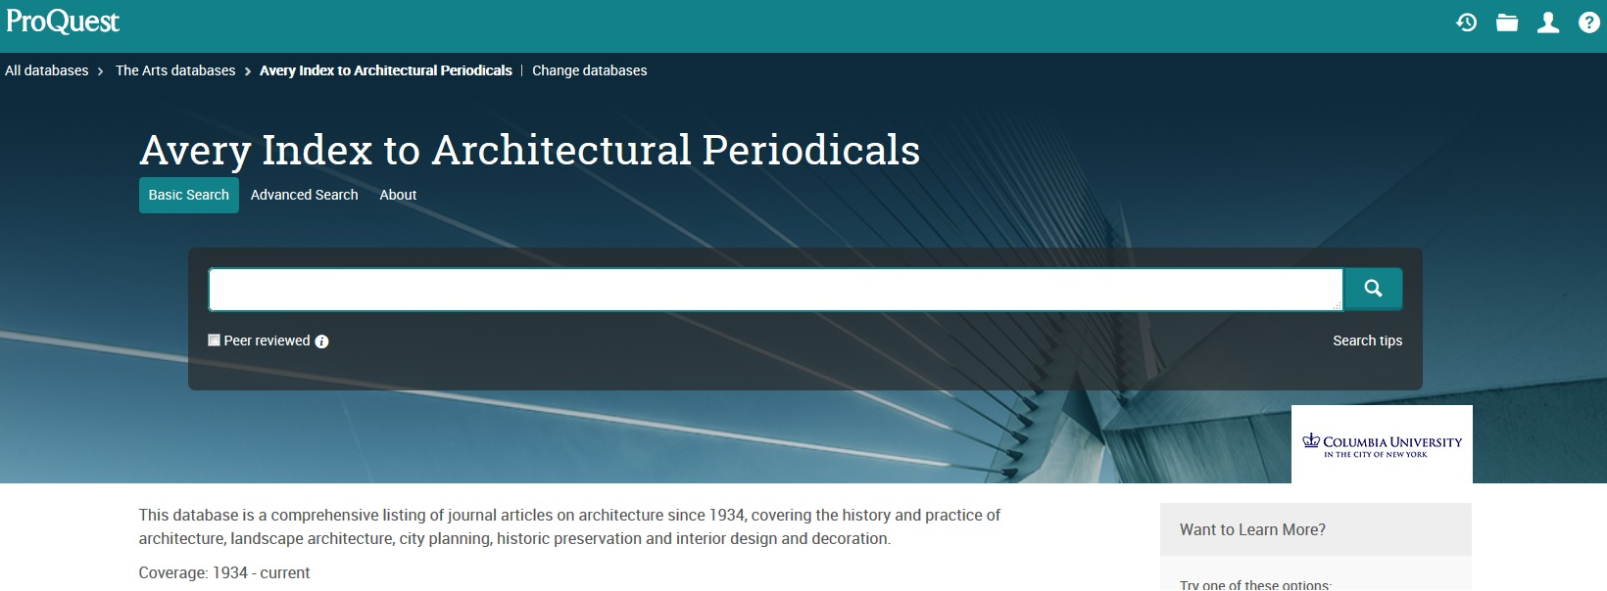
Access to e-resources

Slide 15
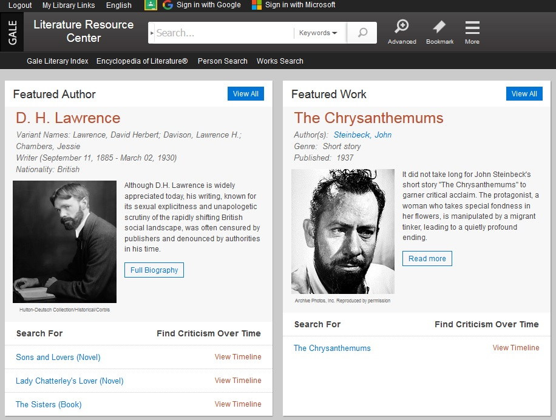
Access to e-resources

Slide 16
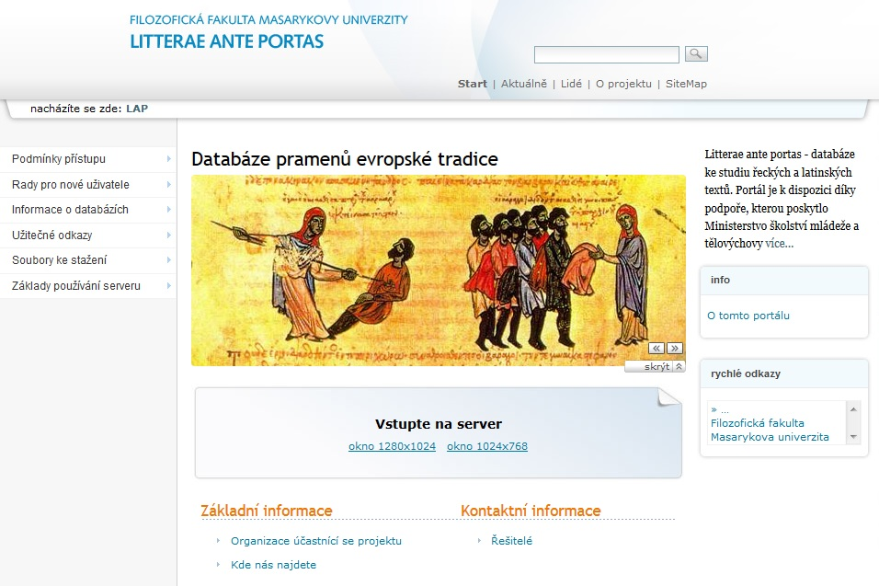
Access to e-resources

Slide 17
What else?
…learning courses
…advertising
…interim (periodic) reports
…statistics
…my role in the project

Slide 18
Future
…project ELIZA of the LR programme of ME ends next year
…Czech E-lib
Thank you for your attention.
zagorova@phil.muni.cz, Office for Research and Development, Faculty of Arts, Masaryk University

